Slide 1


Green Pace
Security Policy Presentation
Developer: Evan Bush
Notes:
Hi everyone. My name is Evan Bush, and I am here to review Green Pace’s Security Policy.

Slide 2

OVERVIEW: DEFENSE IN DEPTH
Notes:
The Green Pace security policy is essential as our team grows to ensure uniformity in best practices. This presentation will review our standardized security measures, highlighting our commitment to recognizing potential attack surfaces and vulnerabilities. We've organized our approach around 10 key security principles and coding standards, and we employ external testing methods complemented by C++ unit tests in Visual Studio to identify and address vulnerabilities.

Slide 3
THREATS MATRIX
Likely STD-003-C STD-004-C STD-005-C STD-007-CPP STD-008-CPP STD-009-C STD-010-C | Priority STD-001-CPP STD-002-C STD-003-C STD-006-C STD-007-CPP STD-008-CPP STD-009-C STD-010-C
Low priority STD-004-C STD-005-C | Unlikely STD-001-CPP STD-002-C STD-006-C
Notes:
STD-001-CPP - Do not write syntactically ambiguous declarations:
Summary: Avoid using ambiguous syntax. Rely on uniform initialization syntax to clearly define declarations.
STD-002-C - Use correct integer precisions:
Summary: Make sure integers represent values with the appropriate precision. Don't rely your conclusions solely on size.
STD-003-C - Do not attempt to modify string literals:
Summary: Because string literals are frequently kept in read-only memory, avoid changing them.
STD-004-C - Exclude user input from format strings:
Summary: Protect format strings from user inputs to avoid potential security flaws.
STD-005-C - Only free memory allocated dynamically:
Summary: Ensure that memory deallocation is only applied to dynamically allocated memory.
STD-006-C - Use a static assertion to test the value of a constant expression:
Summary: Implement static assertions to check that constant expressions are correct.
STD-007-CPP - Honor exception specifications:
Summary: Adhere to declared exception specifications. Avoid throwing unexpected exceptions to prevent unintentional program termination.
STD-008-CPP - Use valid iterator ranges:
Summary: Ensure that iterators function within valid ranges. This ensures they operate within their intended boundaries and privileges.
STD-009-C - Ensure division operations do not result in divide-by-zero errors:
Summary: In division operations, avoid divide-by-zero mistakes and consequent overflow.
STD-010-C - Ensure size arguments for variable length arrays are in a valid range:
Summary: Validate size arguments for variable length arrays, especially when derived from untrusted data.

Slide 4
10 PRINCIPLES
Validate Input Data
STD-002-C
STD-010-C
Heed Compiler Warnings:
STD-003-C
STD-009-C
Architect and Design for Security Policies:
STD-004-C
Keep It Simple:
(No associated standards)
Default Deny:
(No associated standards
Adhere to the Principle of Least Privilege:
STD-005-C
STD-007-CPP
STD-008-CPP
Sanitize Data Sent to Other Systems:
(No associated standards)
Practice Defense in Depth:
STD-004-C
Use Effective Quality Assurance Techniques:
STD-006-C
Adopt a Secure Coding Standard:
(No associated standards)
Notes:
Validate Input Data: To maintain strong security, always validate data from untrusted sources, such as external data, command-line arguments, and user files.
Heed Compiler Warnings: To ensure that your code is secure, use both static and dynamic testing tools and set compiler warning sensitivity to the highest level.
Architect and Design for Security Policies: Creating system designs with security in mind, using segmented and privilege-based structures, is a key component of security policy architecture.
Keep It Simple: To reduce errors and provide a stable, secure environment, avoid complexity in system designs.
Default Deny: Access should always default to "deny", relying on specific permissions for approvals rather than exclusions.
Adhere to the Principle of Least Privilege: Grant access only at the necessary level for a specific role, minimizing permissions to reduce potential threats.
Sanitize Data Sent to Other Systems: To thwart potential injection threats, sanitize data before delivering it to connected systems.
Practice Defense in Depth: Utilize multi-layered defenses to reduce security weaknesses and control risks by practicing "defense in depth."
Use Effective Quality Assurance Techniques: To improve code security, give top priority to comprehensive testing, including fuzz, penetration, and source code audits.
Adopt a Secure Coding Standard: To provide comprehensive security, organizations should impose uniform Secure Coding Standards throughout their development environment.

Slide 5
CODING STANDARDS
STD-002-C: Use correct integer precisions
STD-010-C: Ensure size arguments for variable length arrays are in a valid range
STD-001-CPP: Do not write syntactically ambiguous declarations
STD-006-C: Use a static assertion to test the value of a constant expression
STD-003-C: Do not attempt to modify string literals
STD-004-C: Exclude user input from format strings
STD-005-C: Only free memory allocated dynamically
STD-009-C: Ensure that division and remainder operations do not result in divide-by-zero errors
STD-008-CPP: Use valid iterator ranges
STD-007-CPP: Honor exception specifications
Notes:
This ranking provides a comprehensive and prioritized list of coding standards, taking into account multiple factors that contribute to the overall security posture of an application. By analyzing each standard's potential risk, likelihood of occurrence, complexity, and potential impact, we've constructed an order that represents the gradient of urgency and importance. Addressing vulnerabilities in this structured manner ensures a systematic approach to security, allowing teams to first tackle the vulnerabilities that pose the most significant threats. As we move down the list, while the issues might be less immediate, they are still integral to maintaining a robust security policy. In essence, this ranking serves as a roadmap, guiding developers and security teams to enhance the security of their systems progressively.

Slide 6
ENCRYPTION POLICIES
Encryption in Rest
Encryption at rest safeguards data stored on disks, databases, and other devices, ensuring it remains unreadable without the correct encryption keys.
Encryption in Flight
Encryption in flight secures data as it travels over networks, ensuring any intercepted data remains indecipherable without the necessary decryption keys.
Encryption in Use
Encryption in use protects data actively being processed or viewed by software, ensuring security even in memory or cache.
Notes:
Encryption in Rest:
When we discuss 'Encryption at Rest', we're focusing on how we protect our data when it's stationary, such as when it's saved on our hard drives or databases. Imagine it as a vault. Even if someone were to break into our storage systems, without the right key, all they'd find inside would be gibberish. This policy is our commitment to ensuring that our stored data remains confidential, even in the face of potential breaches.
Encryption in Flight:
Moving on to 'Encryption in Flight'. This is all about securing our data when it's on the move, traveling from one point to another over networks. Think of it as securing a package being shipped. Even if someone intercepts our data package, they can't understand its contents without the decryption key. This ensures that our data remains confidential, from its point of origin to its destination.
Encryption in Use:
Lastly, we have 'Encryption in Use'. This might not be as commonly discussed, but it's equally crucial. It's about safeguarding our data when it's being actively used or processed by our applications. Imagine having a secure reading room where even the documents you're actively reading are protected. This policy ensures that even when data is in the spotlight, being processed or viewed, it remains shielded from potential threats.

Slide 7
TRIPLE-A POLICIES
Authentication
Authentication confirms a user's, system's, or application's legitimacy through various methods like passwords, biometrics, and multi-factor authentication.
Authorization
Authorization defines permissions for authenticated entities, allowing or restricting access based on roles or standards.
Accounting
Accounting tracks and logs user activity, providing an essential audit trail for compliance, analysis, and investigations.
Notes:
Authentication:
When we mention 'Authentication', we're talking about how we validate the identity of our users, systems, or applications. Think of it as a checkpoint. Before you're allowed in, you need to prove who you are. Whether it's through something you know, like a password; something you have, like a smart card; or something you are, like a fingerprint - authentication is our gatekeeper. It ensures that only those who are truly authorized get access, protecting against unauthorized entries and impersonation.
Authorization:
Next, we have 'Authorization'. Once you're authenticated, what can you do? That's where authorization comes into play. It's like getting a wristband at an event. Your wristband color or type determines which areas you can enter. Authorization ensures users only access what they're supposed to, based on their roles or responsibilities. It's our way of ensuring the right person gets the right access and nothing more, protecting data and functions from unintended access.
Accounting:
Lastly, there's 'Accounting'. After authentication and authorization, we need a way to monitor what's happening. Accounting is like having CCTV cameras in a building. It meticulously logs who did what, when, and any changes made. This isn't just about keeping tabs; it's about accountability. It provides us with a history, a trail that we can review, analyze, and use for audits or investigations. Whether it's for compliance or to investigate an incident, accounting ensures we have the records we need.

Slide 8
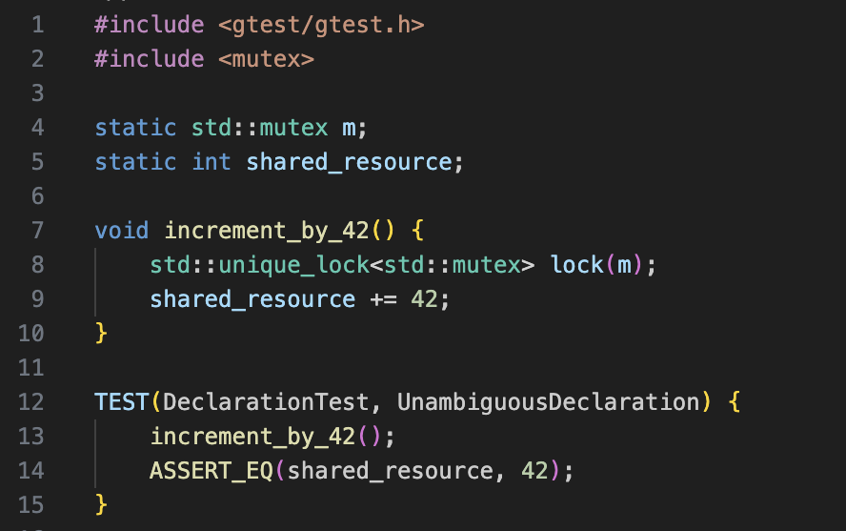
Unit Testing
Are all declarations syntactically unambiguous?
STD-001-CPP - Do not write syntactically ambiguous declarations
Notes:
By making sure that our declarations are clear in this test, we are stressing the readability and clarity of our code. As we all know, ambiguous declarations can cause developers to become confused and can result in undesired behaviour. Our goal in conforming to the STD-001-CPP standard is to make our code as unambiguous and simple as feasible. By managing our mutex with the std::unique_lock in this example of conforming code, we have ensured thread safety. Utilizing the increment_by_42 function, we may increase our shared resource by 42. The function acts as anticipated and increases the shared_resource by the specified amount, according to our test. This exemplifies how powerful crystal-clear declarations can be in assuring predictable and secure code behavior.

Slide 9
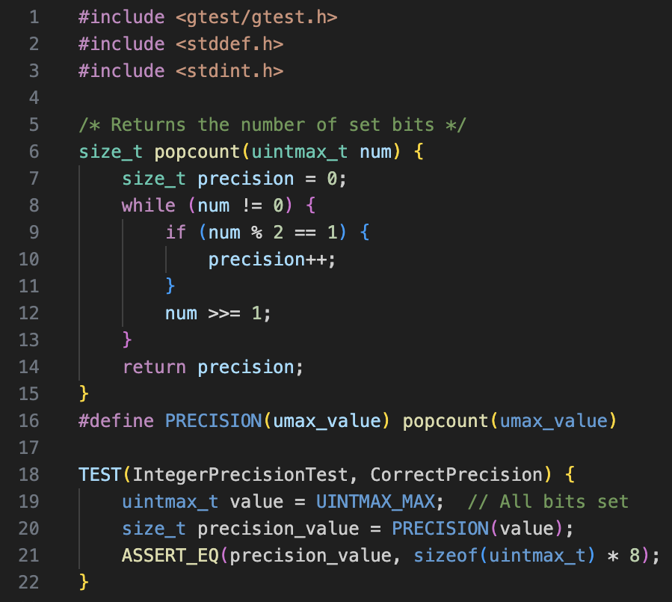
Unit Testing
Are integer precisions correctly implemented?
STD-002-C - Use correct integer precisions
Notes:
In the second test, we explore the idea of integer precision in more detail. As is well known, maintaining data integrity requires proper representation of integer precision. The STD-002-C standard emphasizes precise integer precisions in order to underline the significance of this. We've included a popcount function to our example of conforming code, which precisely counts the number of set bits and provides us with the precision. We evaluate our precision computation against the UINTMAX_MAX, which represents the maximum value for the greatest integer type, to make sure it is reliable. The test demonstrates that our precision calculation matches the integer type's anticipated precision. Because of the constant awareness of the precise capabilities of our integer types, our code is more secure and predictable.

Slide 10
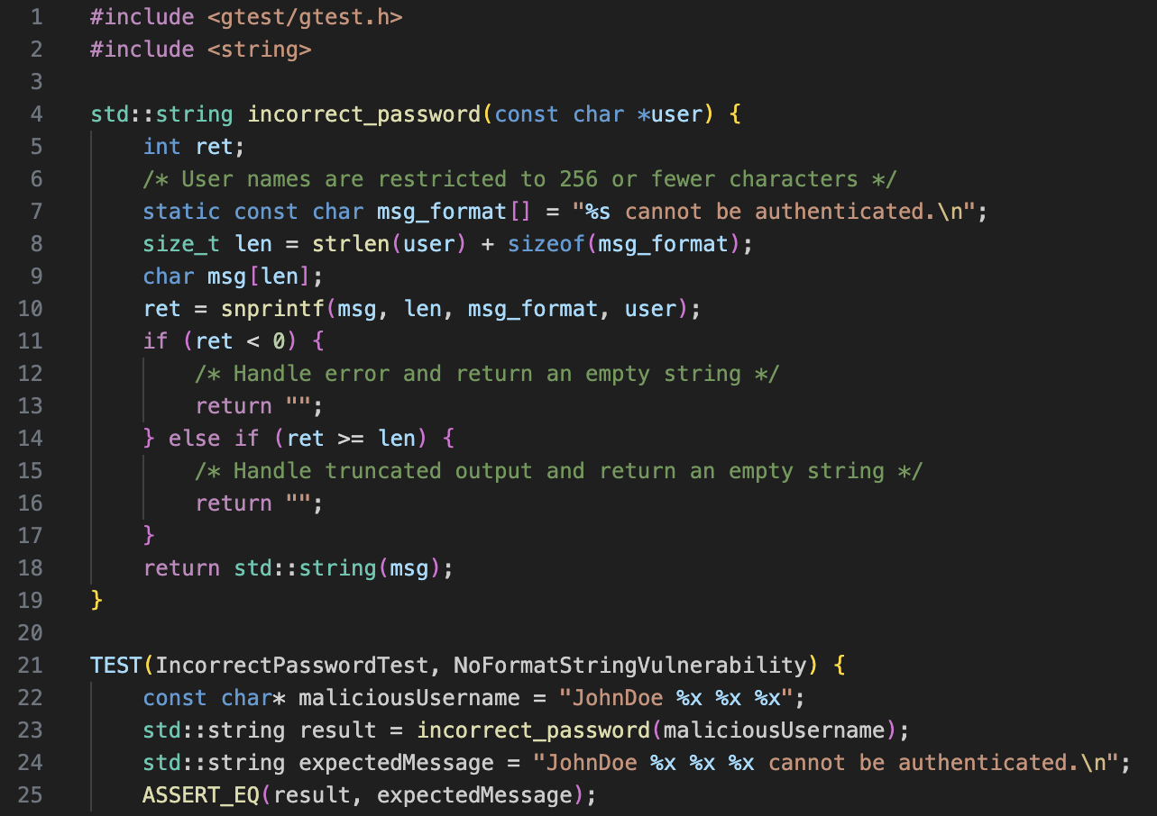
Unit Testing
Are format strings free from user input?
STD-004-C - Exclude user input from format strings
Notes:
In our third test, we're safeguarding against format string vulnerabilities. The test feeds a simulated malicious username, JohnDoe %x %x %x, to the incorrect_password function, aiming to confirm the function treats the %x tokens as plain text, not format specifiers. A successful test ensures the function's output matches the expected benign message, demonstrating our function's resistance to potential format string exploits.

Slide 11
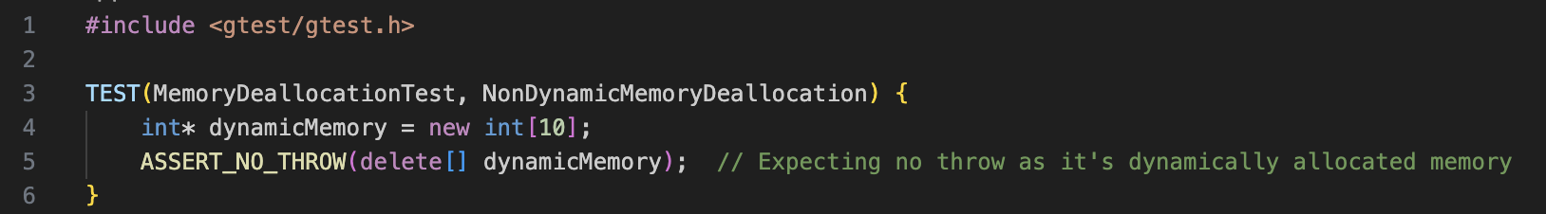
Unit Testing
Is memory deallocation restricted to dynamically allocated resources?
STD-005-C - Only free memory allocated dynamically
Notes:
In our fourth test, we're focusing on memory management, particularly the deallocation of dynamically allocated memory. Improper memory deallocations can lead to heap corruption, a serious vulnerability. By adhering to the STD-005-C standard, we ensure we're only freeing memory that's been dynamically allocated. This test checks the valid scenario of deallocating dynamic memory, emphasizing that any deviation from this pattern would lead to undefined behaviors and potential risks.

Slide 12

AUTOMATION SUMMARY
Notes:
Pre-production:
Assess and Plan: In the 'Assess and Plan' phase, automation starts with threat intelligence tools that automatically gather and analyze information about emerging threats. These tools reside at the very beginning of our workflow, ensuring we're proactive from the outset.
Design: Design: During the 'Design' phase, automated security design verification tools ensure that as we sketch out our system, any potential design vulnerabilities are flagged. These tools are integrated into our design platforms, making security a seamless part of the design process.
Build: In the 'Build' phase, the compiler plays a crucial role. As our codebase is being built, the compiler not only translates the code but also has integrated security checks. Automated tools scan for vulnerabilities in real-time as code gets compiled, ensuring our build is secure right from the start.
Verify and Test: The 'Verify and Test' phase is rife with automation. Vulnerability scanning tools automatically check our codebase, while our testing suites, integrated with security plugins, validate that our code is both functionally robust and secure. This is where a bulk of our security automation tools reside.
Production:
Transition and Health Check: As we transition into 'Production', automated deployment tools with integrated security checks ensure our configurations are secure. Penetration testing tools, often automated, simulate potential attacks to validate our defenses.
Monitor and Detect: The 'Monitor and Detect' phase leverages Security Information and Event Management (SIEM) systems, which are inherently automated, processing vast logs and flagging anomalies. Automated intrusion detection systems scan for unusual patterns, ensuring we're promptly alerted.
Respond: In the 'Respond' phase, our incident response platforms, equipped with automated playbooks, kick into action. These playbooks, predefined automation scripts, guide our response, ensuring swift and effective mitigation.
Maintain and Stabilize: Lastly, in 'Maintain and Stabilize', automated assessment tools regularly check our systems against security baselines. In case of any incidents, automated recovery tools help roll systems back to a safe state.

Slide 13
RISKS AND BENEFITS
Problems
Lack of clarity
Security Gaps
Solutions
Comprehensive Security Approach
Automation
Risks or Benefits
Acting Now
Benefits: Reduce potential vulnerabilities, ensure compliance, and improve trust with stakeholders.
Risks: disruption of current workflows
Waiting
Benefits: More time to plan
Risks: Potential security vulnerabilities remain unaddressed
Notes:
Problems:
Lack of Clarity & Security Gaps: Security vulnerabilities exist at every stage of the software lifecycle, from design to deployment, without a clear, automated, and comprehensive security methodology.
Solutions:
Comprehensive Security Approach: The implementation of a comprehensive lifecycle security approach, from "Assess and Plan" in pre-production to "Maintain and Stabilize" in production, guarantees that security is integrated at every stage.
Automation: Integrating automated security tools and inspections throughout the procedure offers quicker, more reliable, and comprehensive security coverage.
Risks or Benefits:
If you act now:
Benefits: Immediate integration of security measures will decrease potential weaknesses, guarantee compliance, and increase stakeholder trust.
Risks: The initial setup and integration may interfere with established procedures, necessitating some adjustment time for teams.
If you wait:
Benefits: More time for planning and potentially for locating better tools or solutions.
Risks: Unaddressed security vulnerabilities raise the probability of breaches, non-compliance, and reputational harm.

Slide 14
RECOMMENDATIONS
Current Gaps
Adaptability
Feedback Mechanisms
Human Factor
Complexity
Over-reliance on Automation
Future Potential Gaps and Improvements
Integration with New Technologies
Cross-border Data Transfers
Quantum Computing Threats
Notes:
Current Gaps:
Adaptability: The present approach can find it difficult to adjust swiftly to risks or regulatory changes that emerge quickly.
Feedback Mechanisms: Improved reactive actions and ongoing feedback loops are required.
Human Factor: Lack of emphasis on regular training or awareness programs leaves human-related vulnerabilities unchecked.
Real-World Example of Human Factor: The 2017 Equifax data breach could have been avoided with a more adaptive strategy. Despite a patch being available for the exploited vulnerability, it wasn't applied in time, leading to a significant data breach (Shepardson, 2017).
Complexity: Overly complicated procedures may result in mistakes.
Over-reliance on Automation: Potential risk of missing nuanced threats not yet recognized by automated tools.
Future Potential Gaps and Improvements:
Integration with New Technologies: As IoT and AI grow more pervasive, the security strategy must change to handle the problems they provide.
Cross-border Data Transfers: As a result of globalization, data frequently moves across international borders, and the policy will need to take these circumstances into consideration.
Real-World Example: The advent of GDPR radically changed how companies had to handle European citizens' data. A forward-looking security policy would have anticipated such regulatory changes and prepared accordingly (Privacy International, 2018).
Quantum Computing Threats: Threats from quantum computing include the potential for many present encryption techniques to become obsolete as the technology advances.

Slide 15
CONCLUSIONS
Recommendations for Standards
Regular Training
Zero Trust Architecture
Multi-factor Authentication Continuous Monitoring
Data Minimization
Notes:
Recommendations for Standards:
Regular Training: Adopt guidelines modeled after the NIST cybersecurity framework, which places a strong emphasis on ongoing education and awareness.
Zero Trust Architecture: Adopt a "never trust, always verify" mentality to make sure that each request is verified and approved.\
Real-World Example: Google's implementation of the Zero Trust model, known as "BeyondCorp", shifts access controls from the network perimeter to individual users and devices, a more secure approach in today's diverse and distributed environment (Google, n.d.).
Multi-factor Authentication: MFA should become the norm for all access points.
Continuous Monitoring: Adopt standards that place a focus on continuous monitoring and prompt reaction to hazards.
Data Minimization: To minimize the risk of a breach, only gather and store the minimal amount of data.

Slide 16
REFERENCES
Google. (n.d.). BeyondCorp Enterprise. Google Cloud.
https://cloud.google.com/beyondcorp-enterprise?hl=en
Privacy International. (2018). Why and how GDPR applies to companies
globally. https://www.privacyinternational.org/long-read/2207/why-and-how-gdpr-applies-companies-globally#:~:text=At%20a%20minimum%2C%20companies%20that,altering%2C%20generating%2C%20disclosing%2C%20and%20destroying
Shepardson, D. (2017). Equifax failed to patch security vulnerability in March:
former CEO. Reuters. https://www.reuters.com/article/us-equifax-breach-idUSKCN1C71VY

